Slide 1
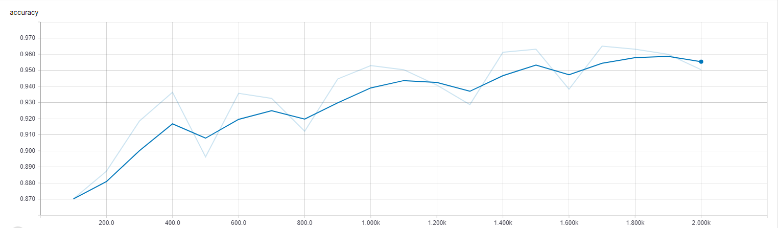
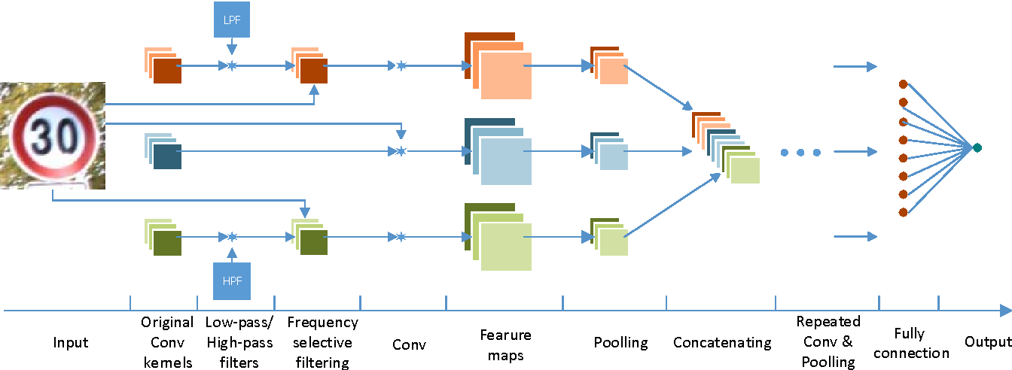
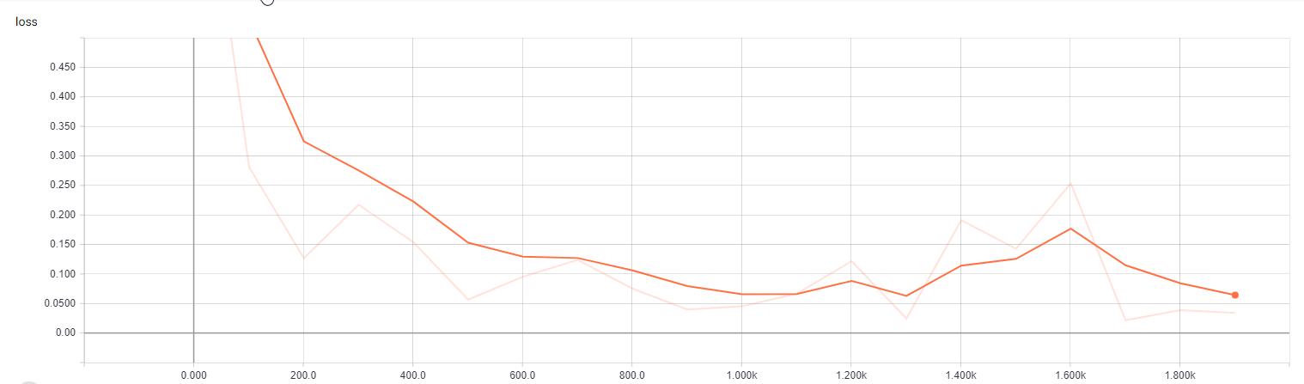
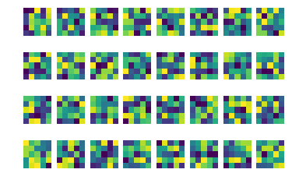




Autonomous Vehicle AI Analysis
Ankit Patel, Cristian Vives, Dr. Joseph Ernst, Mark Rogers, Di Jin
Hume Center Colloquium, April 18th 2018
Objective
Investigate how adversarial artificial intelligence prevention can help ensure the safety of future vehicles
Project Background:
Using Machine Learning and Artificial Intelligence to classify a large traffic sign dataset using a convolutional neural network (CNN)
Adversarial Phase: manipulate images within dataset to test vulnerabilities of machine learning and our CNN model and ensure accuracy
Creating the Neural Network:
5 layers (Convolutional, Flattening, Pooling, Fully Connected)
Weights, biases, and filters to create the feature maps
Centered around the Estimator API and TensorFlow
Key features of CNN:
Dropout: Randomly ignoring neuron nodes during the training phase to prevent overfitting
Estimator API: Allows for high-level implementation of machine learning model
Training and Testing Neural Network:
Images were split 80/20 to between training and testing
Adversarial Phase:
Gaussian noise for image manipulation
Results of Adversarial Phase:
(show result when fed back into CNN for testing)
(Another histogram plotting the results)
Figure 3. Accuracy vs. Number of Images trained
Figure 1. Simple Image showing “under the hood” structure of CNN
Sample Images from the dataset:
Number of different classes: 2
Data Processing:
Over 7000 raw images varying in size
All images gray scaled to reduce channels
Images were upscaled by padding or downscaled
Figure 4. Computed loss vs. Number of Images trained
Figure 2. Output of filters of the primary layer
Notes:
Your page is set to be enlarged 200% so do not change the page size to fit another poster size.

